Slide 1

Hospital Patient Care Operations Analytics System
A DATABASE Using MYSQL
Presented By :
GADIMUDI JYOTHI

Slide 2
About Me
Gadimudi Jyothi, B.Tech – Data Science(CSD)
Why Data Science?
Data Science offers the power to predict trends, make smarter decisions, solve real-world problems, and build a successful career with high demand, attractive salaries, diverse job opportunities, and flexible work options.
Work Experience : Fresher
LinkedIn : https://www.linkedin.com/in/gadimudi-jyothi-41a9642b9/
GitHub : https://github.com/Gadimudi30

Slide 3
Agenda
Objective of the Project
Database Structure
ER Diagram
Key Analysis Questions
Experience/Challenges
Conclusion

Slide 4
Objective of the Project :
The objective of this project is to design and implement a Hospital Patient Care Operations Analytics System that efficiently stores and manages hospital-related data within a relational database.
The system needs to manage various aspects of hospital operations, including patient information, appointments, treatments, doctors, and rooms.
The system should maintain the integrity and consistency of data by using relational tables with appropriate primary keys, foreign keys, and relationships.
The system should allow efficient management and querying of hospital data, providing insights into patient demand, appointment behavior, treatment outcomes, doctor performance, and room utilization.
The system should help identify operational issues such as cancellations, no-shows, rescheduled appointments, waiting times, and multiple treatment attempts.
The goal is to support the hospital's operations team in making data-driven decisions, improving resource utilization, and enhancing overall patient care and operational efficiency.

Slide 5
Database Structure :
This project contains 5 interrelated tables:
• Patients • Appointments • Treatments • Doctors • Rooms
These tables are connected using Primary Keys and Foreign Keys to maintain relational database integrity.
The relationships between these tables help in efficiently managing and analyzing patient information, appointments, treatments, doctors, and hospital room resources.

Slide 6
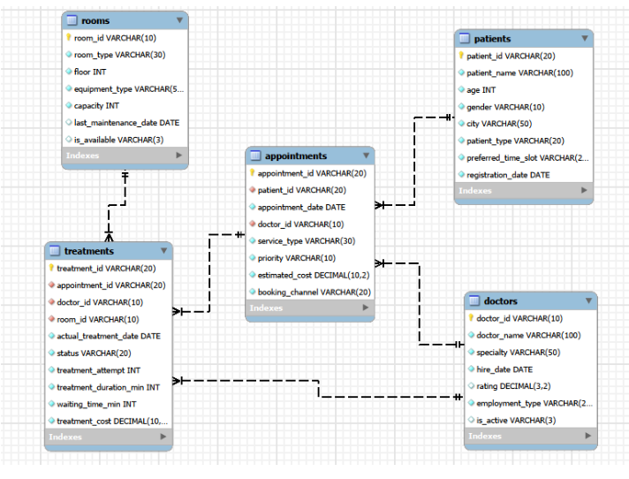
ER Diagram

Slide 7


Basic Analysis / Data Exploration :
1. What is the total number of patients?
Query :
Output :
The PATIENTS table contains 400 patients in total.
The COUNT(*) query successfully retrieves the total number of patients from the patients table.

Slide 8

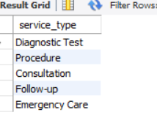
2. What are the different medical service types?
Query :
Output :
The DISTINCT query successfully identifies the different medical service types available in the hospital.

Slide 9


3. What is the total estimated appointment value?
Query :
Output :
The SUM() function is used to calculate the total estimated appointment value from the appointments table

Slide 10

4. What is the average treatment duration?
Query :
Output :
The AVG() function successfully calculates the average treatment duration from the treatments table

Slide 11
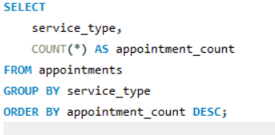
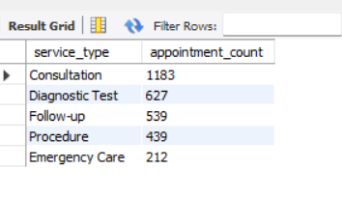
2.Understand Patient and Appointment Demand :
1.Compare appointments across service types and priorities?
Query :
Output :
The appointment analysis successfully compares service types and priority levels to identify differences in appointment demand.

Slide 12
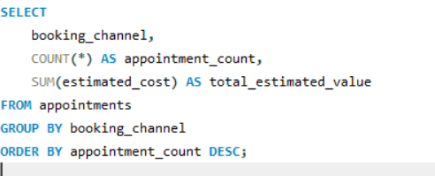
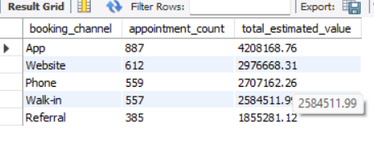
2.Examine booking channels and their contribution to demand?
Query :
Output :
The booking channel analysis shows the contribution of different booking channels to the overall appointment demand.

Slide 13
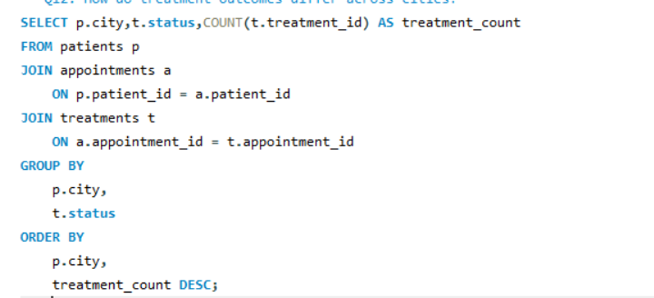
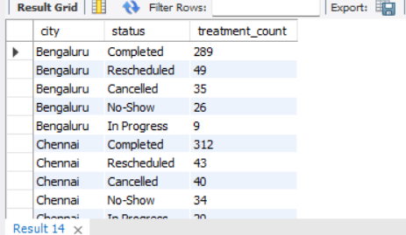
3.Evaluate Treatment Performance :
1. Compare treatment outcomes across cities?
Query :
Output :
The analysis compares treatment outcomes across different cities to understand variations in treatment performance.

Slide 14
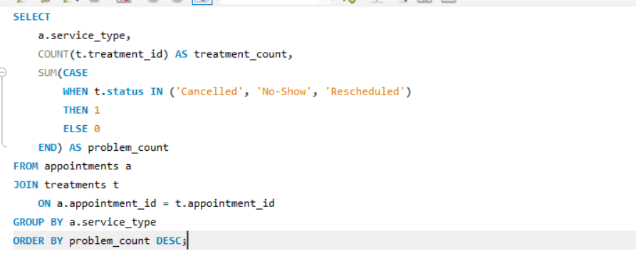
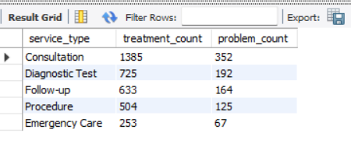
2.Compare Completed, Cancelled, No-Show, Rescheduled, and In Progress outcomes?
Query :
Output :
The analysis compares different treatment outcomes, including Completed, Cancelled, No-Show, Rescheduled, and In Progress.

Slide 15
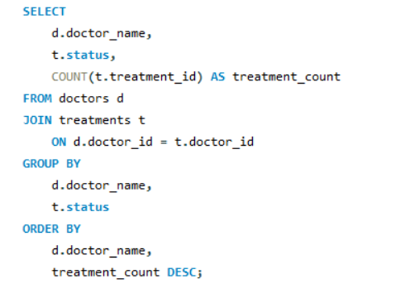
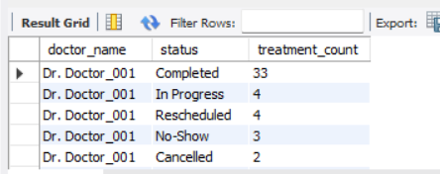
4. Understand Doctor and Room Performance :
1. Compare doctor performance across treatment outcomes?
Query :
Output :
The analysis compares doctor performance based on different treatment outcomes.
The query helps identify the number of treatments handled by each doctor and their corresponding outcomes.

Slide 16
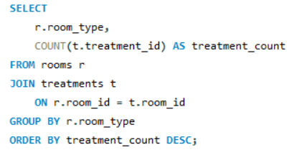
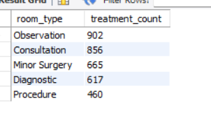
2.Compare room usage across room types and equipment types?
Query :
Output :
The query helps identify which rooms and equipment types are used more frequently for treatments.

Slide 17
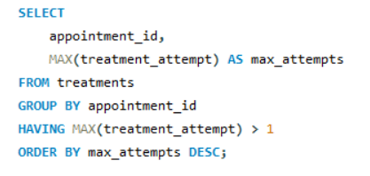
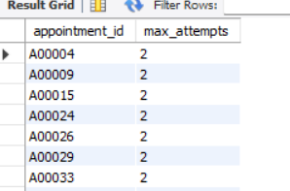
5.Identify Treatment and Appointment Problems
1.Identify appointments requiring multiple treatment attempts?
Query :
Output :
The analysis identifies appointments that have more than one treatment record.

Slide 18
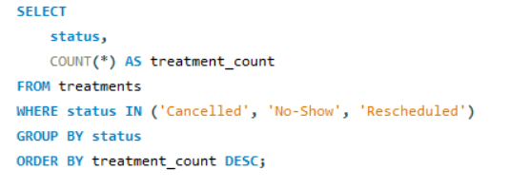
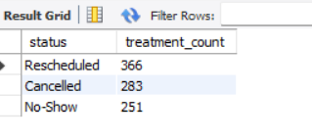
2.Find common problem statuses and patterns?
Query :
Output :
The analysis identifies common problem statuses such as cancellations, no-shows, and rescheduled appointments.

Slide 19
Challenges / Experiences:
Understanding the relationships between patients, appointments, treatments, doctors, and rooms was one of the initial challenges.
Creating the database with the correct Primary Keys and Foreign Keys required careful planning.
Writing SQL queries using JOIN, GROUP BY, COUNT(), SUM(), and AVG() helped improve my SQL skills.
Analyzing data across multiple tables was challenging but helped me understand relational database concepts better.
Identifying meaningful patterns from the query results helped me improve my analytical and problem-solving skills.
Converting SQL query results into business insights and practical recommendations was a valuable learning experience.
Overall, the project provided practical experience in database creation, SQL analysis, data interpretation, and business decision-making.

Slide 20
Conclusion :
Successfully designed and implemented a Hospital Patient Care Operations Analytics System using MySQL.
Managed five interrelated tables for patients, appointments, treatments, doctors, and rooms.
Used SQL queries, joins, and aggregate functions to generate meaningful patient, appointment, treatment, doctor, and room insights.
Analyzed appointment demand, treatment outcomes, waiting time, doctor performance, room usage, and operational problems.
Improved understanding of relational database design, primary keys, foreign keys, data integrity, and SQL-based analysis.
“This project helped me understand how SQL can be used to manage real-world hospital data and generate meaningful business insights for better healthcare operations. Thank you.”

Slide 21

THANK YOU

